Slide 1
Swin
Transformer
Block
Swin
Transformer
Block
Swin
Transformer
Block
Swin
Transformer
Block
Images
Patch Partition
Linear Embedding
Patch Merging
Patch Merging
Patch Merging
X2
X2
X6
X2

Slide 2
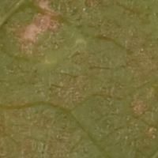
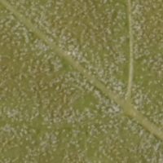
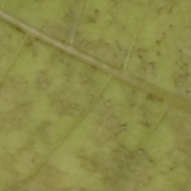
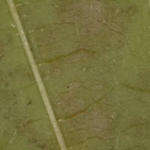
sp
nd
z1
0.5
Swin Transformer
P(OIV > 3)
nf
z2
P(OIV > 5)
ns
z3
P(OIV > 7)
n
z4
P(OIV > 9)
s

Slide 3
